Slide 1
Forecast Delay Durations For New York Bus
Present by : 1. Teng Kai Deng
2. Sit Yie Sian
3. Leong Sheng Mou

Slide 2
Introduction
Transportation, including buses, is a convenient means of travel. Bus services are popular but can be delayed due to traffic, breakdowns, and accidents. A Bus Breakdown and Delay system is proposed to address this issue. The research aims to analyze real-time data, implement the system, and develop a methodology for collecting and analyzing bus route data. This system offers advantages such as estimating travel times, making route modifications, and lowering costs while providing high-quality transportation services for the public.

Slide 3
Problem Statement
Bus staff often use fixed routes which may not be ideal as routes frequently change over time.
Reliance on older route systems can cause traffic jams and delays in bus services. Quick and reliable public transportation is crucial as population's need for transportation increases.
Public transit competes with private autos and minimizing traffic congestion is a critical challenge in Malaysia. Bus businesses operate in a stochastic environment with factors such as changes in passenger demand and city traffic congestion.
Traffic delays during rush hours make it difficult to arrive on time and impact passenger satisfaction and bus company operations.
Travel time and delay are markers of transportation service quality and effectiveness of the transportation system.
Improving bus transit efficiency is a pressing issue.
Quantitative assessment of relevant aspects is needed to create solutions for improving bus transit efficiency.
Research topic is significant due to challenges in urban public transportation.
Major goal of the study is to recommend delay strategies considering sporadic traffic jams and unplanned bus stops along the route.

Slide 4
Solution
Bus vendors use the Bus Breakdown and Delay system to log and notify OPT of delays.
The system is publicly accessible and relies on real-time updates from school bus vendor staff.
One approach to develop the system is supervised learning using historical data.
Steps include data collection, cleaning, feature selection, algorithm selection, model training, evaluation, deployment, and continuous updating.
The goal is to improve fleet reliability and efficiency by proactively identifying potential issues.

Slide 5
Algorithm
Gradient Boosting Regression Tree
Multi-layer Perceptron
Neural Network Algorithm
XGboost
ADA Boosting

Slide 6
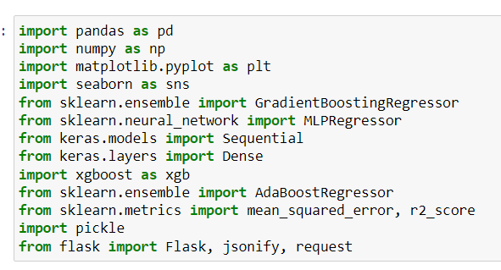

Slide 7
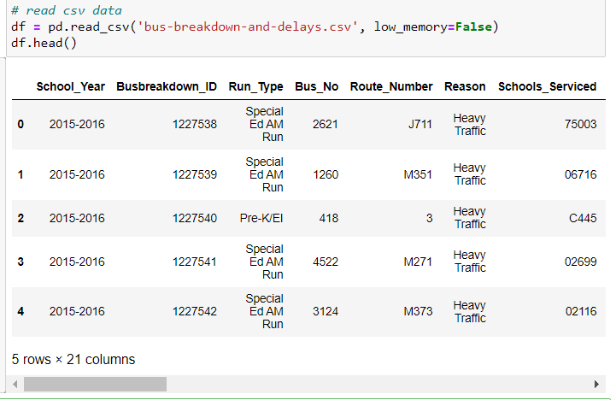

Slide 8


Slide 9
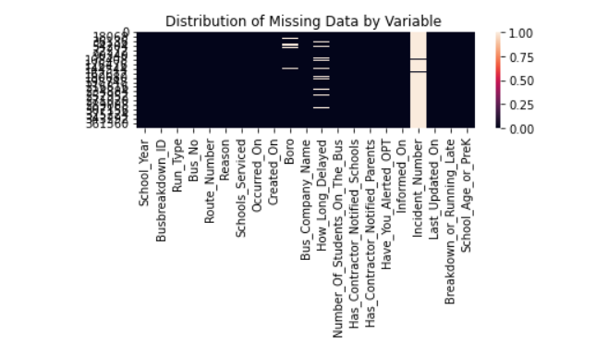

Slide 10
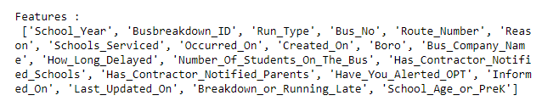

Slide 11
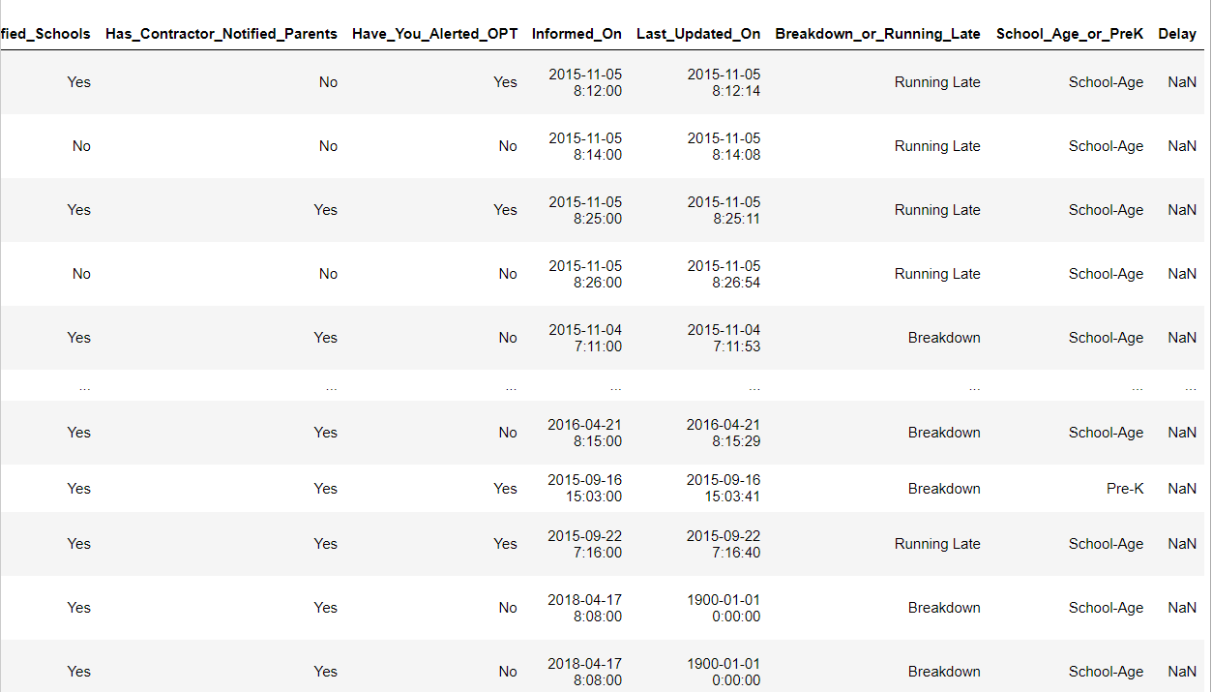

Slide 12
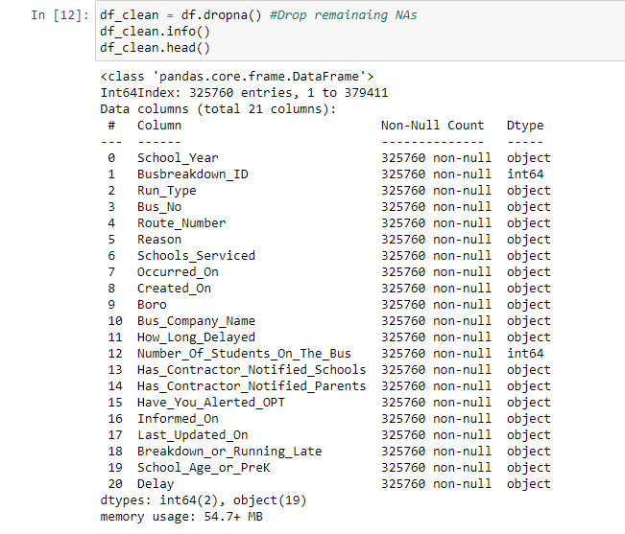

Slide 13
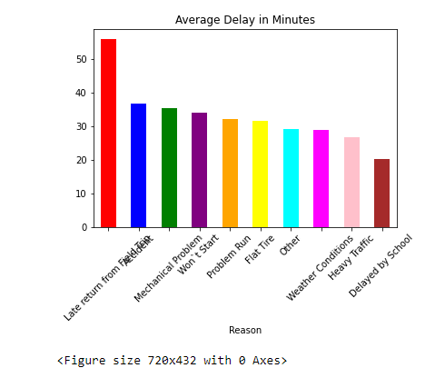

Slide 14
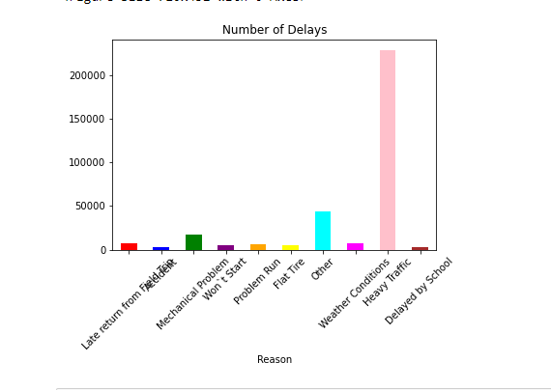

Slide 15
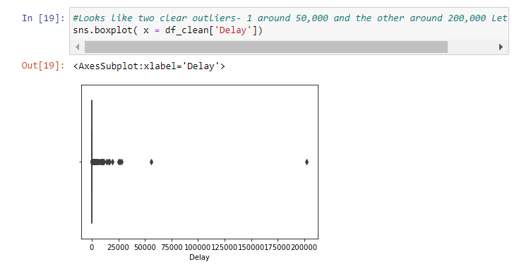

Slide 16
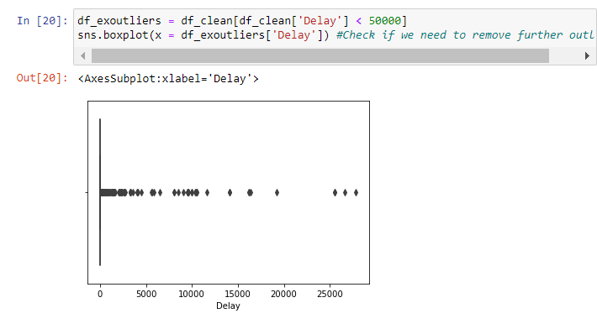

Slide 17
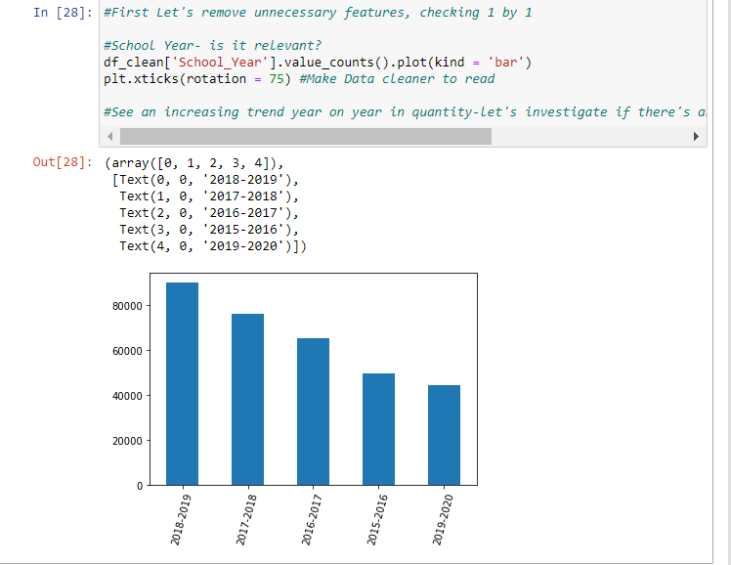

Slide 18
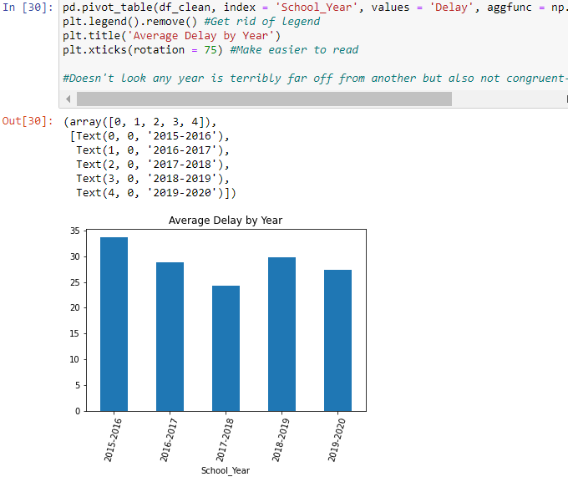

Slide 19
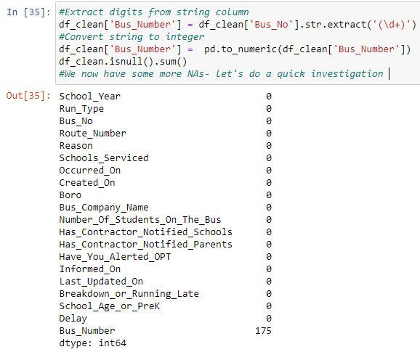

Slide 20
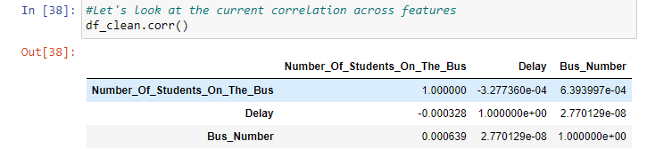

Slide 21
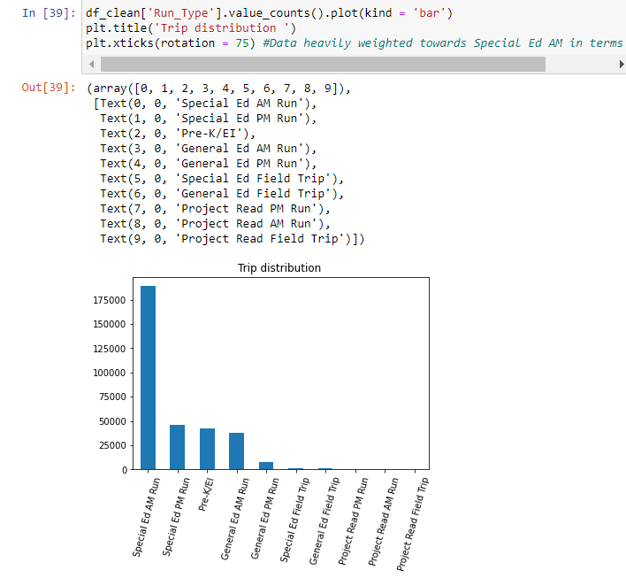

Slide 22
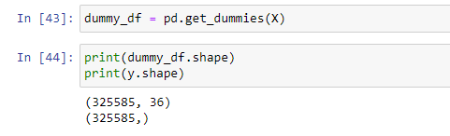
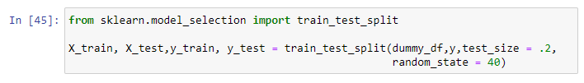

Slide 23
Feature 1

Slide 24
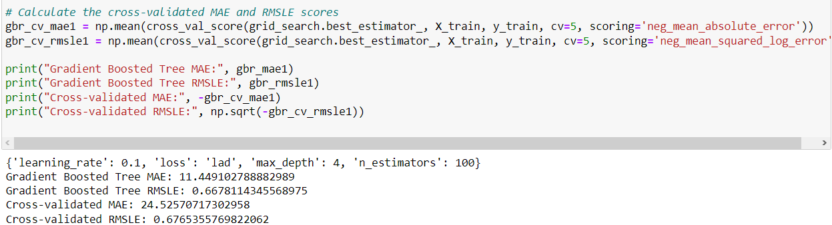
Gradient Boosted Tree

Slide 25
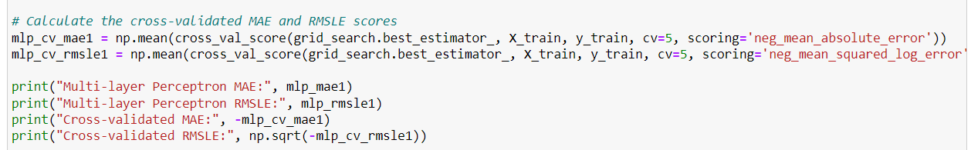

Multi layer Perceptron (MLP)

Slide 26

Neural Network

Slide 27
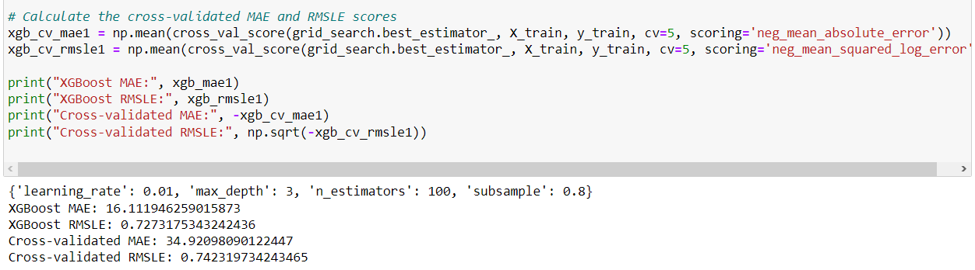
XGBoost

Slide 28
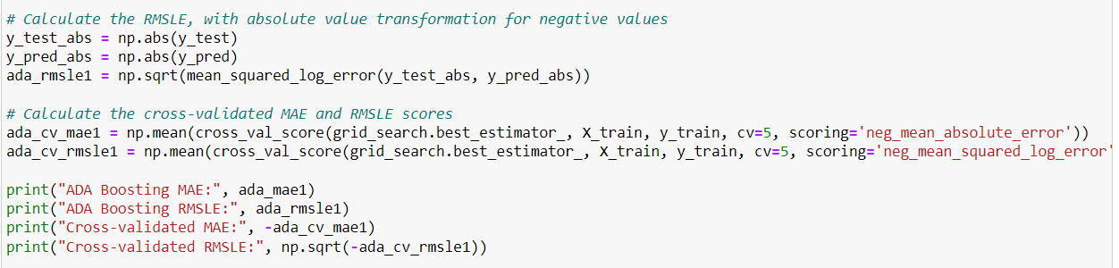
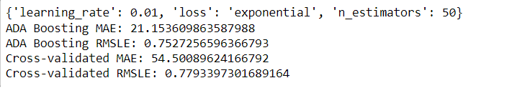
ADA Boosting

Slide 29
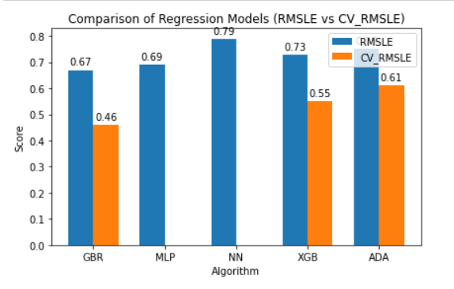
Evaluate Results Feature 1

Slide 30
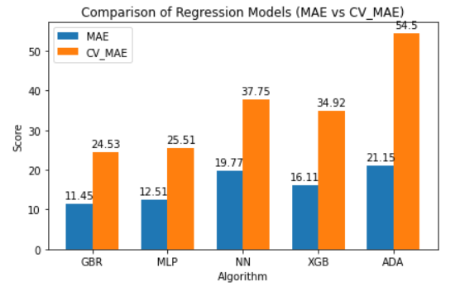

Slide 31
02
Feature 2

Slide 32

Gradient Boosted Tree

Slide 33
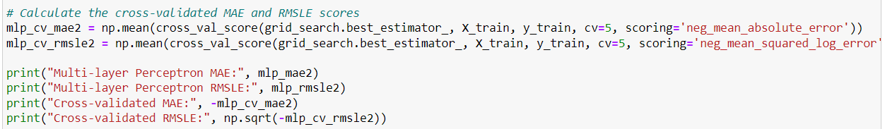
Multi-Layer Perceptron

Slide 34
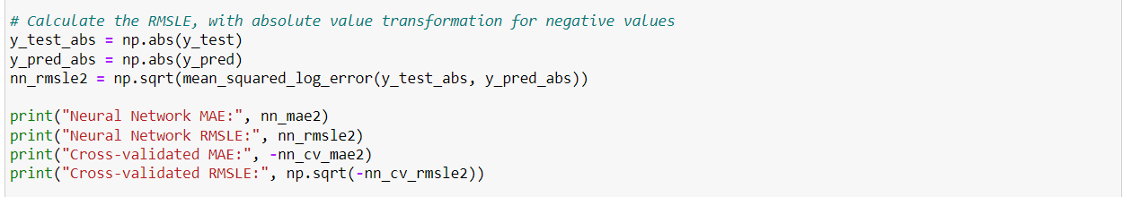

Neural Network

Slide 35
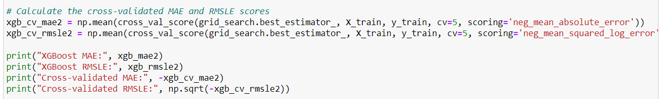
XGBoost

Slide 36
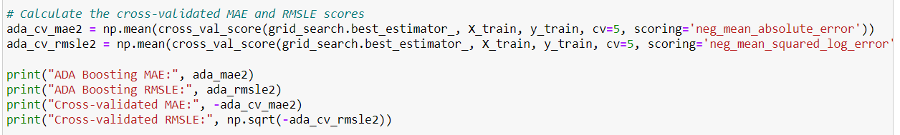
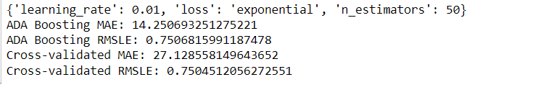
ADA Boosting

Slide 37
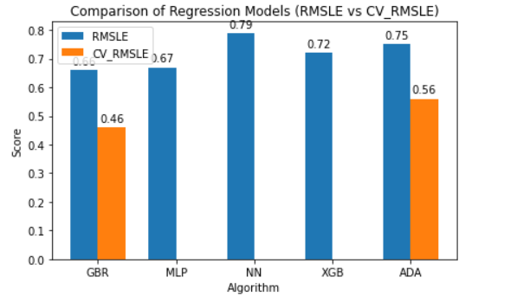
Evaluate Result Feature 2

Slide 38
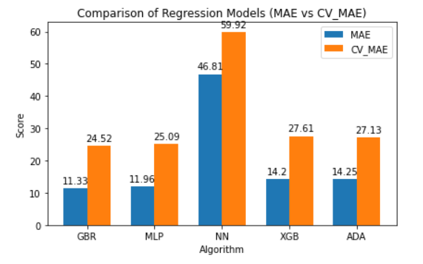
Comparison

Slide 39
Deployment

Slide 40
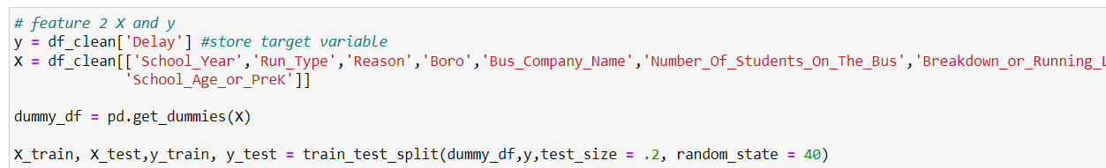
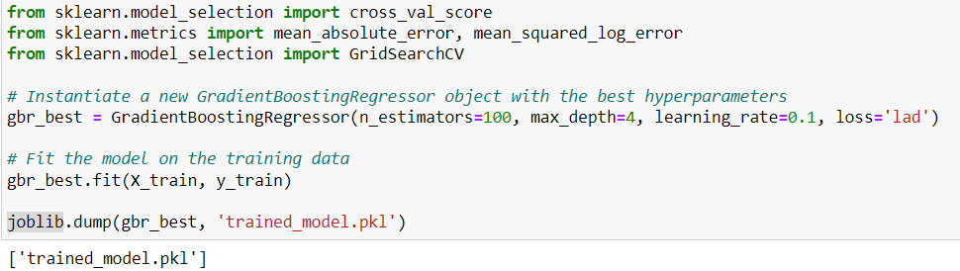

Slide 41
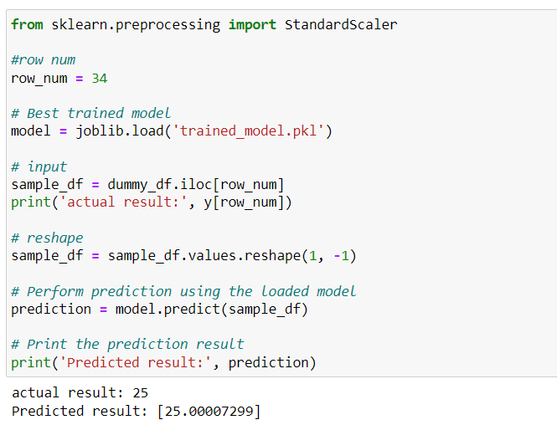

Slide 42
THE END

